Slide 1



SMART INDIA HACKATHON 2025
Problem Statement ID –25048
Problem Statement Title-Gamified learning platform for rural education
Theme-Smart Education
PS Category- Software
Team ID-
Team Name (Registered on portal):Radiant decoders

Slide 2

Gamified learning platform for rural education
Radiant decoders
Problem Solved: Poor internet, rote learning, lack of teaching resources.
For Students (Quest Journey):
Themed syllabus missions (e.g., Mission: Water Purifier).
Learn-Play-Conquer Loop → Learn (multimodal cards), Play (Phaser.js simulations), Conquer (adaptive quizzes with badges & leaderboards).
Works fully offline with Service Workers.
For Teachers (Insight Dashboard):
Aggregates and syncs student progress when online.
Visualizes class performance & knowledge gaps.
Enables data-driven interventions.
2
Notes:
1.7.2013
1.7.2013
2
‹#›
‹#›

Slide 3
TECHNICAL APPROACH
Radiant decoders
Frontend: HTML5, CSS3, JavaScript (ES6+)
Gamification Engine: Phaser.js (Open Source)
Offline & Storage: Service Workers
Backend & Sync: Firebase Firestore (Lightweight, cost-effective)
Multilingual Framework: i18n with JSON-based content structure for easy localization.
Deployment: Progressive Web App (PWA) for cross-platform compatibility and no-store dependencies.
@SIH Idea submission- Template
3
Notes:
1.7.2013
1.7.2013
3
‹#›
‹#›

Slide 4
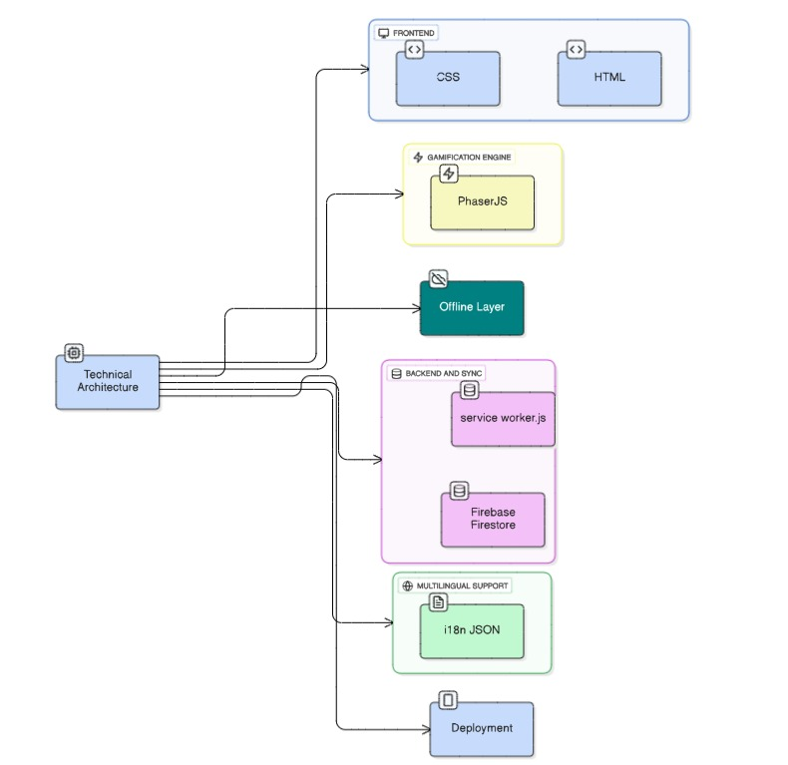
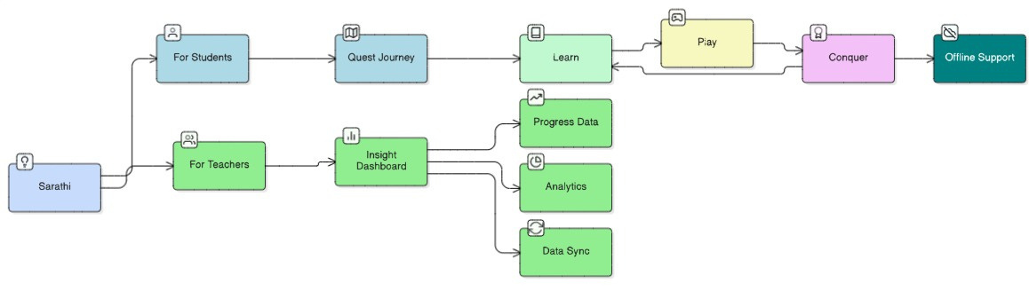
Radiant decoders
@SIH Idea submission- Template
4
Notes:
1.7.2013
1.7.2013
4
‹#›
‹#›

Slide 5
FEASIBILITY AND VIABILITY
Radiant decoders
Technical: Lightweight web tech, offline-first, runs on low-cost devices.
Operational: Easy PWA deployment, minimal teacher training, small update patches.
Financial: Low infra cost, scalable via govt/NGO partnerships, CSR support.
Sustainability: Expandable to more subjects, AI roadmap, aligns with NEP 2020.
@SIH Idea submission- Template
4
Notes:
1.7.2013
1.7.2013
4
‹#›
‹#›

Slide 6
IMPACT AND BENEFITS
Radiant decoders
Student Outcomes:
Increased Engagement & Comprehension: Gamified mission-based learning targets a measurable 15%+ increase in student participation and conceptual understanding.
Equitable Access: Offline-first, multilingual functionality ensures uninterrupted access to quality STEM education, independent of internet connectivity or language barriers.
Experiential Learning: Interactive simulations replace rote memorization, fostering critical thinking and real-world problem-solving skills.
Educator Empowerment:
Data-Informed Instruction: A centralized dashboard provides actionable analytics on student and class performance, enabling targeted academic interventions.
Systemic Transformation:
Policy Alignment: Directly supports the digital infrastructure and experiential learning goals of NEP 2020.
Sustainable Impact: Designed for expansion into new subjects and regions, ensuring long-term viability and national impact.
@SIH Idea submission- Template
5
Notes:
1.7.2013
1.7.2013
5
‹#›
‹#›

Slide 7
RESEARCH AND REFERENCES
Radiant decoders
[Educational Framework] The Octalysis Framework for Gamification
[Technical Architecture] Progressive Web Apps (PWA) & Service Workers - web.dev by Google
[Gamification Engine] Phaser.js Official Documentation
[Policy Alignment] National Education Policy (NEP) 2020 - MHRD, Govt. of India
[Problem Validation] ASER (Annual Status of Education Report) - Pratham Education Foundation
@SIH Idea submission- Template
6
Notes:
1.7.2013
1.7.2013
6
‹#›
‹#›

